Slide 1

School of Computer Engineering
Computer Graphics Mini Project (Review 2)
Atom Simulation
Students Name:
Sakshi Bhingarkar (239)
Vaishnavi Thorave(240)
Samadhan Mane (241)
Guide:
Mrs.Chetana H Nemade

Slide 2
Index
Introduction
Abstract(Aim of your project in five to six lines)
Define Objects
Software/Hardware Requirement
Proposed System
Implementations (description of various functions used in project)
References

Slide 3
Introduction
This program uses OpenGL and GLUT to simulate atoms, including a nucleus and revolving electrons.
It creates an interactive window with a right-click menu to choose elements (Hydrogen, Helium, etc.).
The display function renders text and atom structure based on the selected element.
Keyboard and mouse controls allow for interactions such as rotating electrons, starting/stopping simulations, and changing window states.
The simulation is implemented using 2D circular orbits with color customization. It can be expanded or modified for additional visual effects or scientific representations.

Slide 4
Problem statement
Develop an interactive OpenGL-based C++ simulation to visually represent atomic structures, featuring rotating electrons around a nucleus. Users can select different elements, control animations, and interact using keyboard and mouse inputs to enhance educational understanding of atomic models.
Define Objects
1. Nucleus: The center of the atom, represented as a sphere.
2. Electron: Smaller spheres that move around the nucleus.
3. Orbit/Path: The path electrons follow around the nucleus.
4. User Interaction: Handles input to control elements or animations.
5. Animation Controller: Controls how electrons move around the nucleus.

Slide 5
Hardware/Software Requirement
Hardware:
- CPU: Multi-core (Intel i5 or equivalent)
- RAM: 8 GB+
- GPU: Dedicated with OpenGL support
- Storage: 2 GB free
Software:
- OS: Windows, macOS, or Linux
- OpenGL: Version 3.3+
- Compiler: GCC or MSVC
- IDE: Visual Studio, Code::Blocks, or Eclipse
- Libraries: GLUT/GLFW, GLEW, GLM

Slide 6
Proposed System
Input Module
(User Input)
Data Processing
(Physics Calculations)
Graphics/Rendering
(OpenGL Output)
Control Module
(User Commands)
Output Module (Results/Logs)
|
|

Slide 7
Implementation details
1. Initialization: The init() function sets up a 2D orthographic projection.
2. Drawing Functions:
circle(): Draws a circle for the electron orbit.
nuc(): Draws the nucleus (protons and neutrons).
eleright(), eleleft(), eletop(), etc.: Draw electron paths around the nucleus based on the atom (like Hydrogen, Helium, etc.).
drawString(), drawhead(), and drawsubhead(): Draw text for labels and titles.
3. Animation: `rotate() function rotates electrons in the orbit.
4. Keyboard/Mouse Interaction:
keyboard(): Handles keyboard inputs (e.g., enter, space, etc.).
mouseControl(): Starts the electron rotation when the left mouse button is pressed.
5.Menu System: The code uses a GLUT menu system to allow selection of different atoms and start/stop the electron simulation.

Slide 8
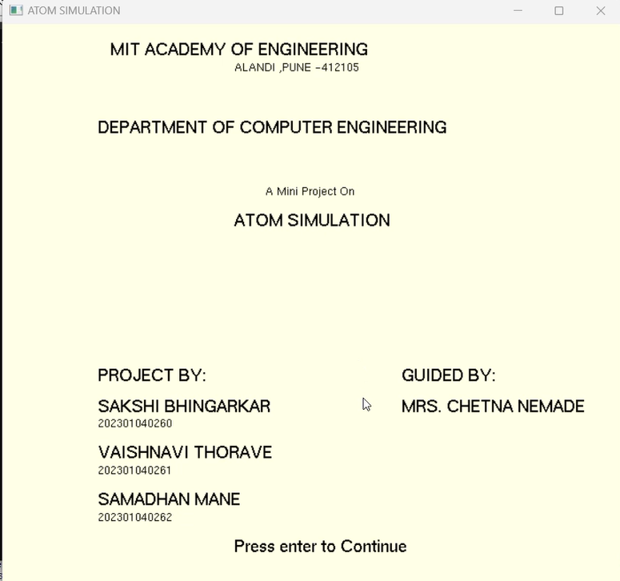
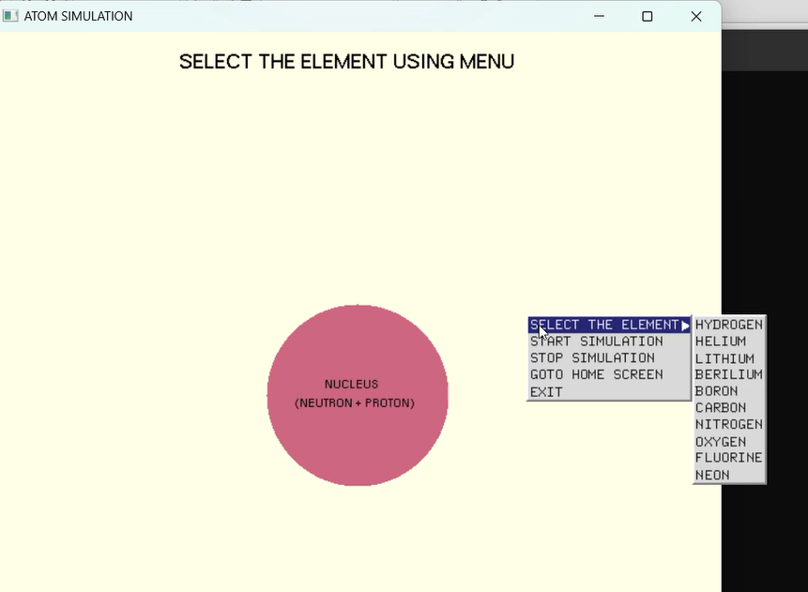
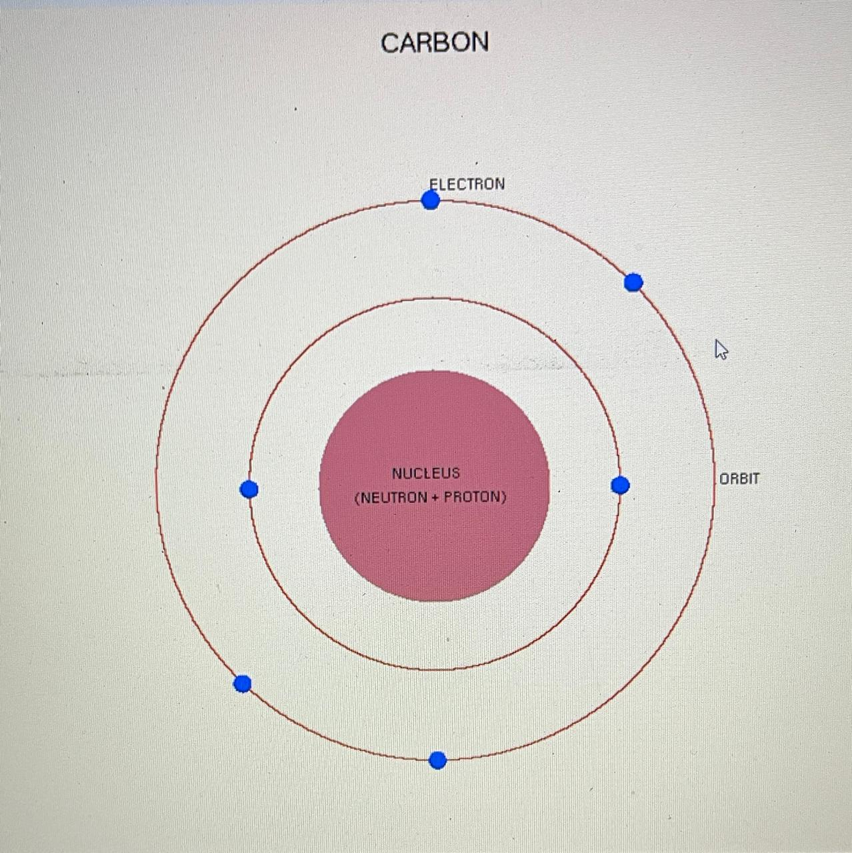
Demonstration

Slide 9
Thank You!!
Any questions.

